Slide 1

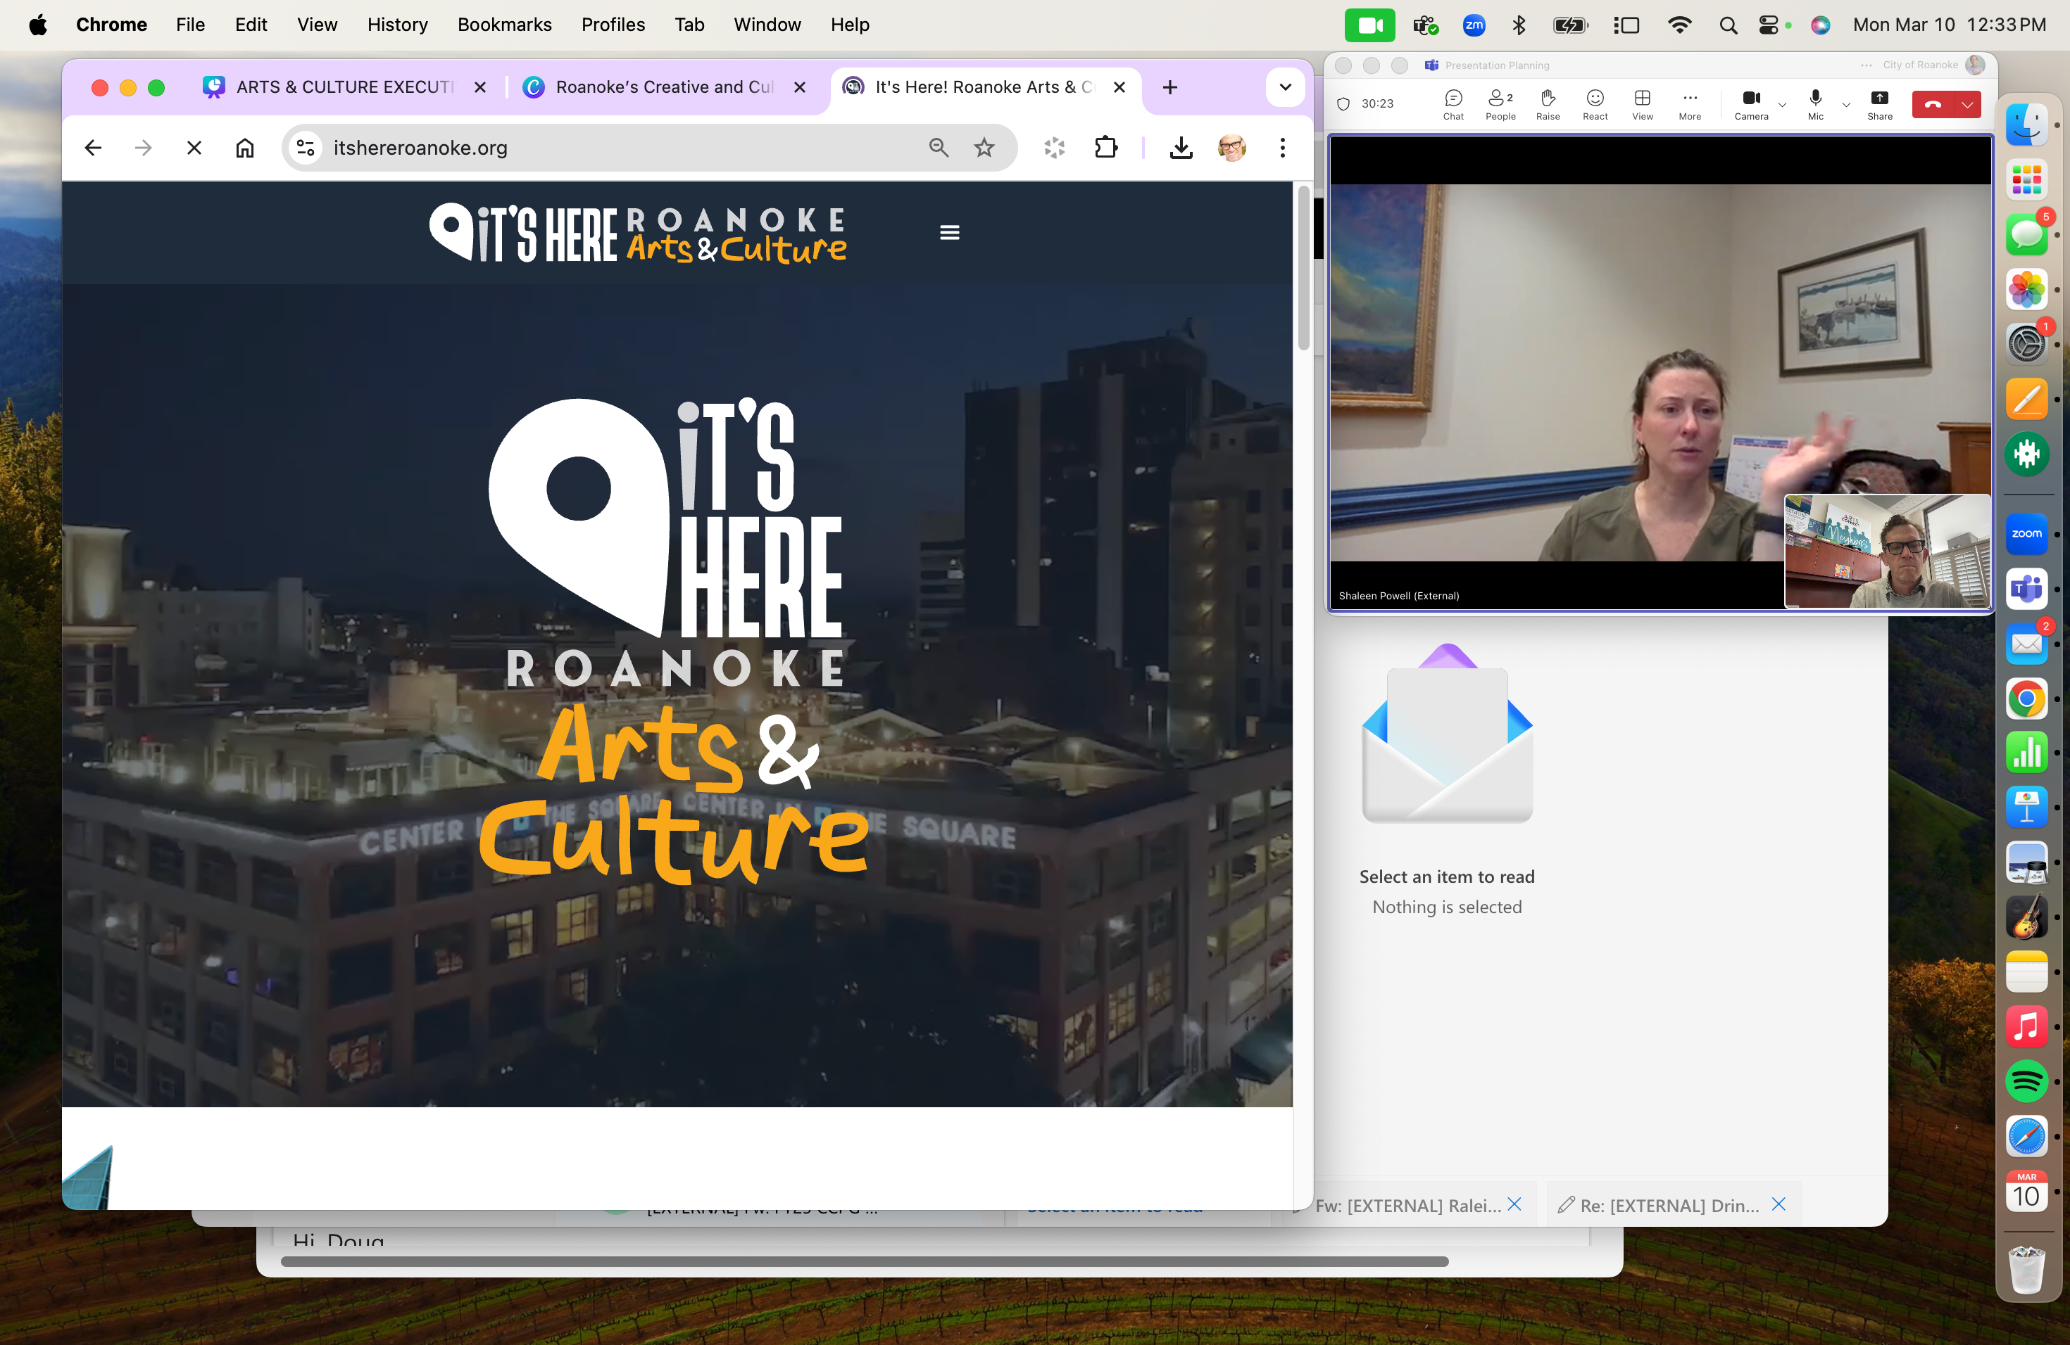

Slide 2


Shaleen Powell
Roanoke Cultural Endowment
Douglas Jackson
City of Roanoke
Roanoke Arts Commission

Slide 3
  Arts as a key asset in building a stronger Roanoke
  The arts & cultural ecosystem
  Resources at work
  Where we’re headed together
AGENDA

Slide 4
Asset Based Community Development

Slide 5
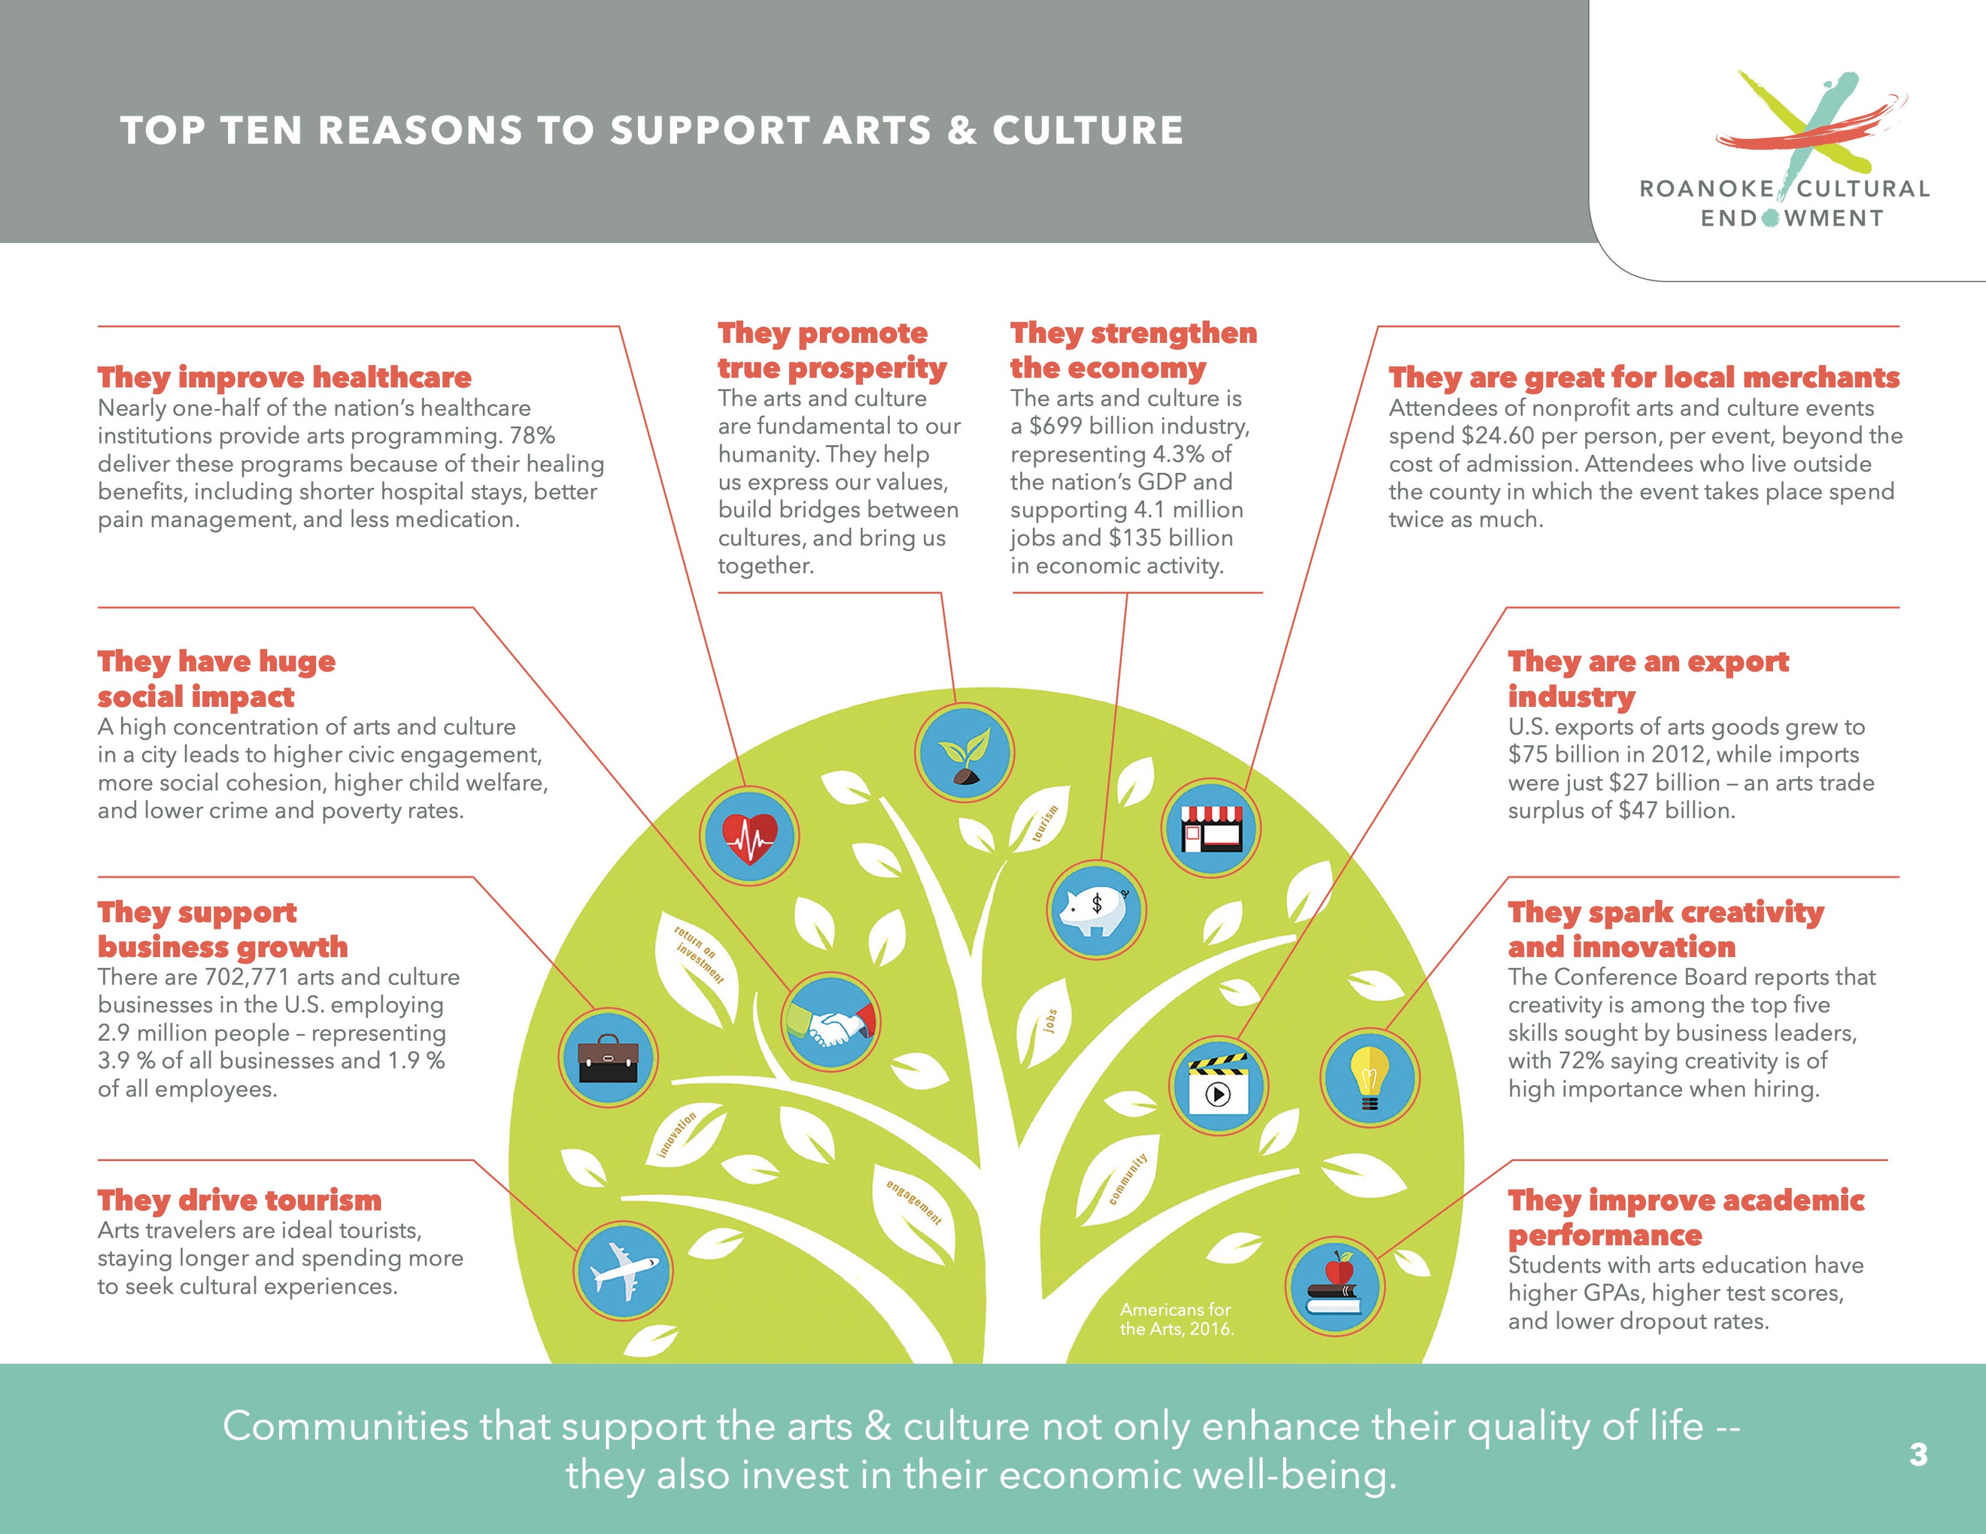

Slide 6
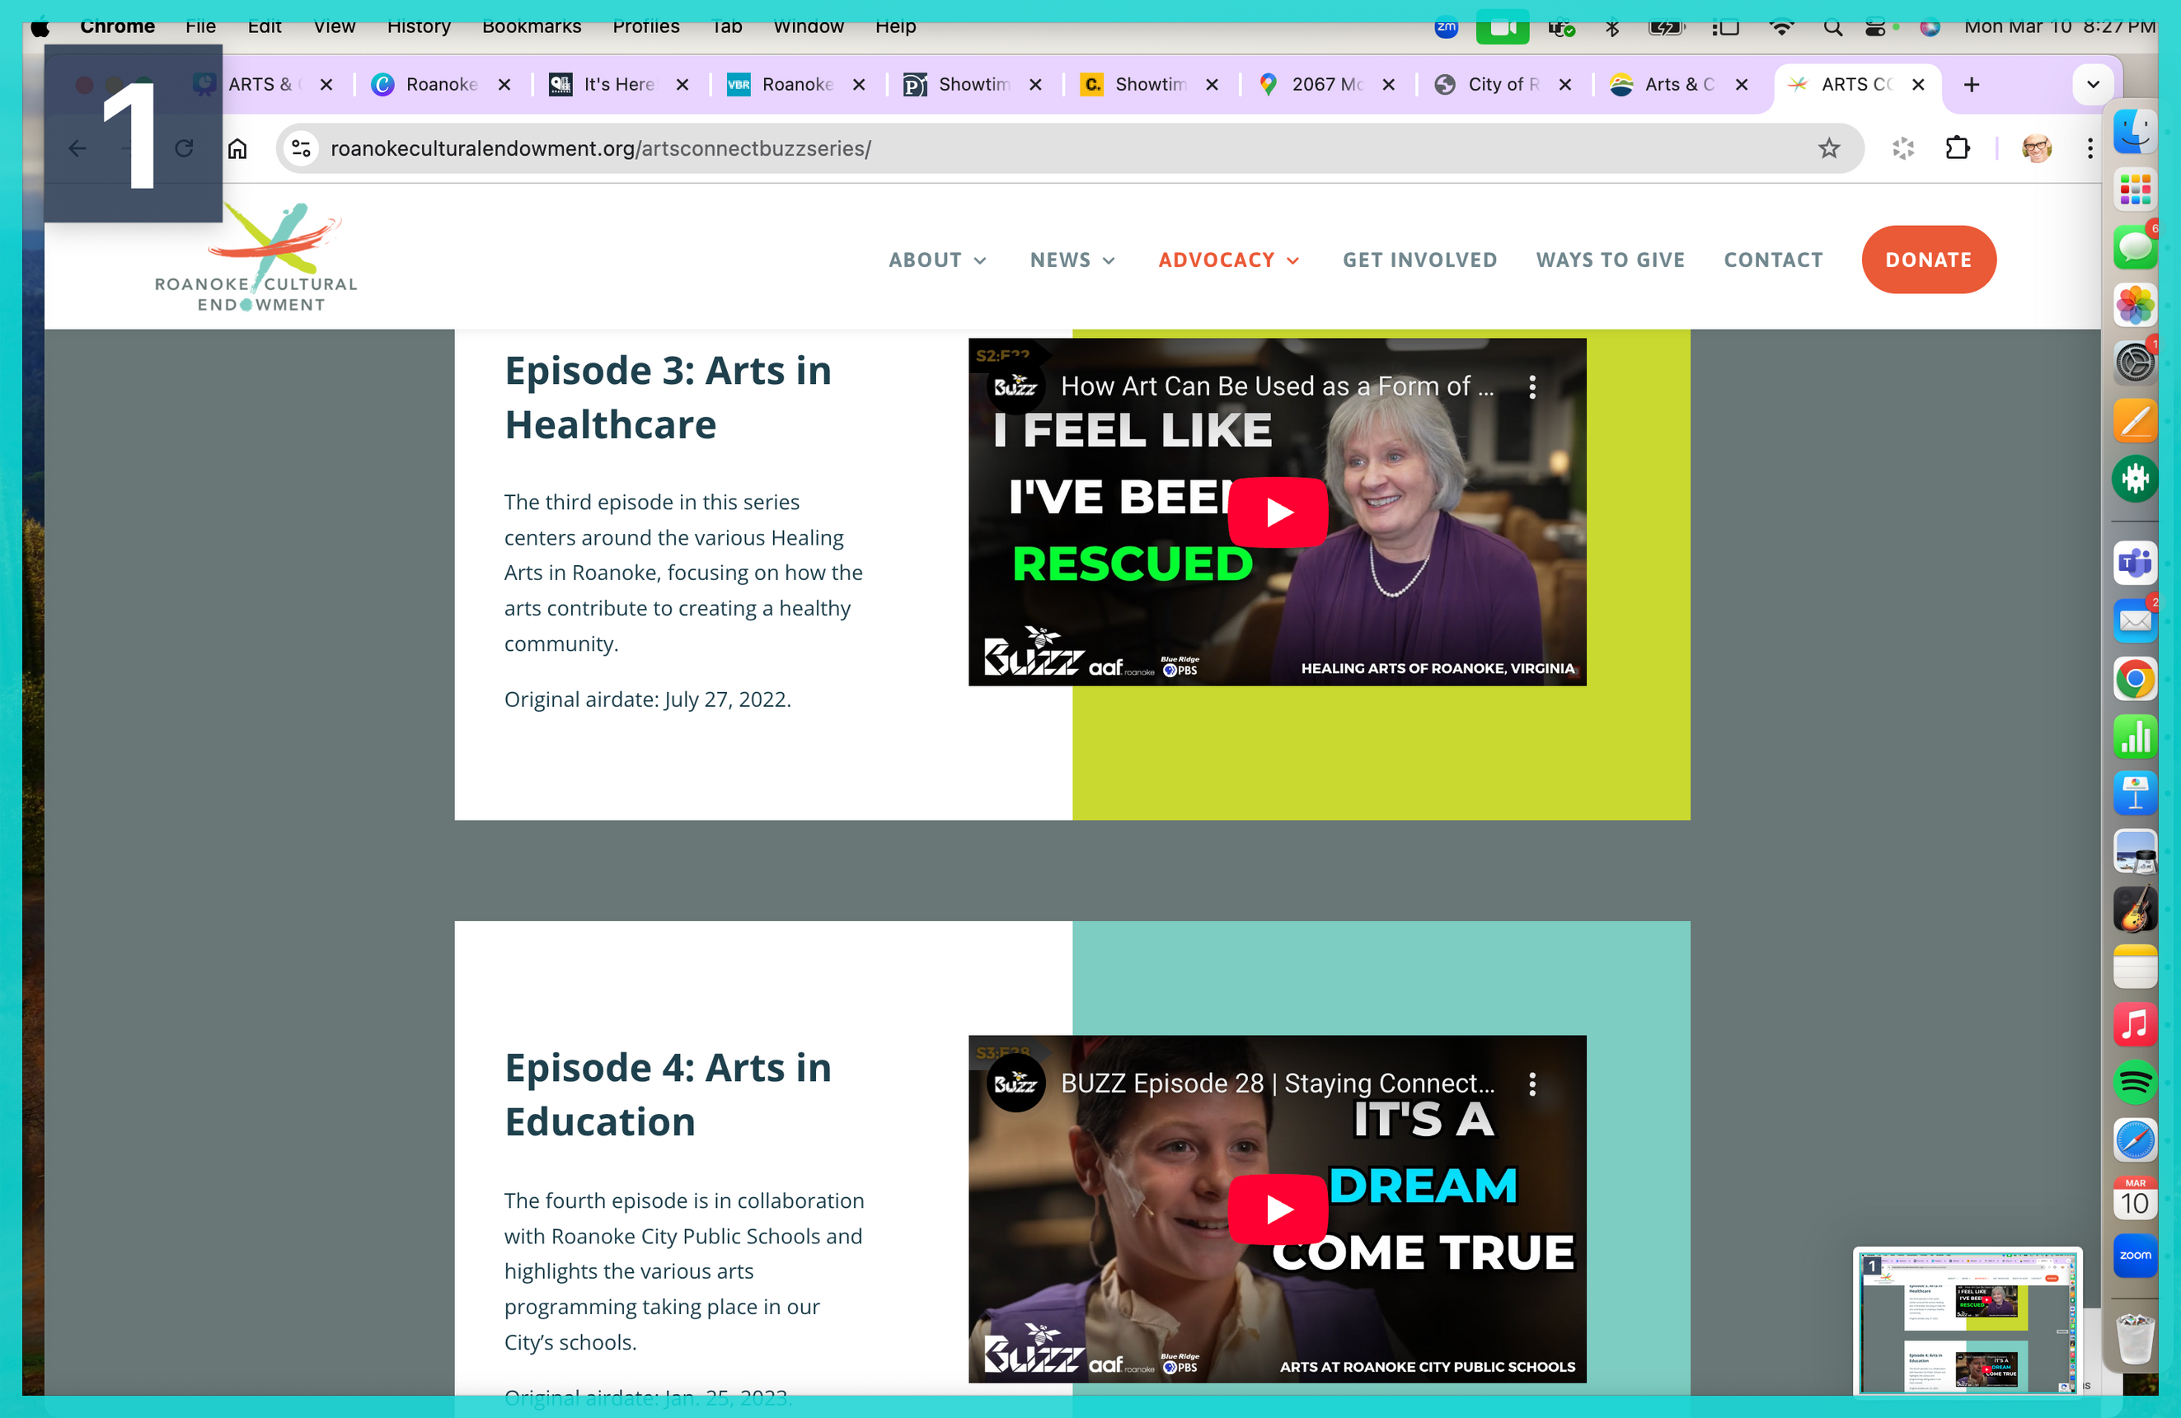
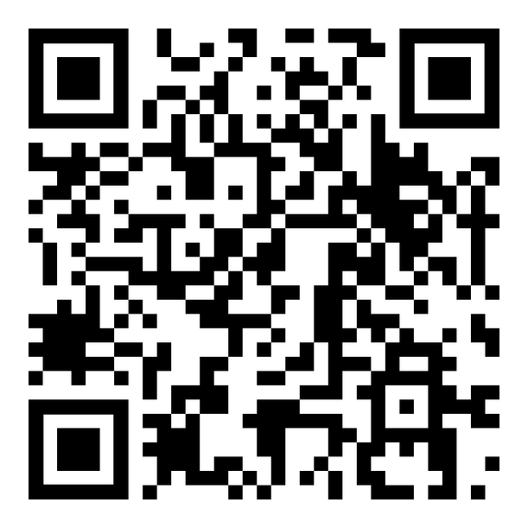
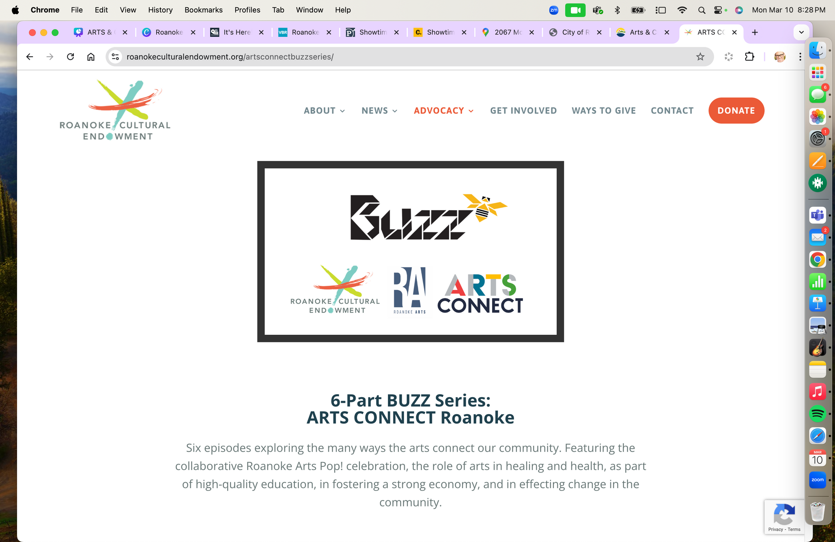

Slide 7

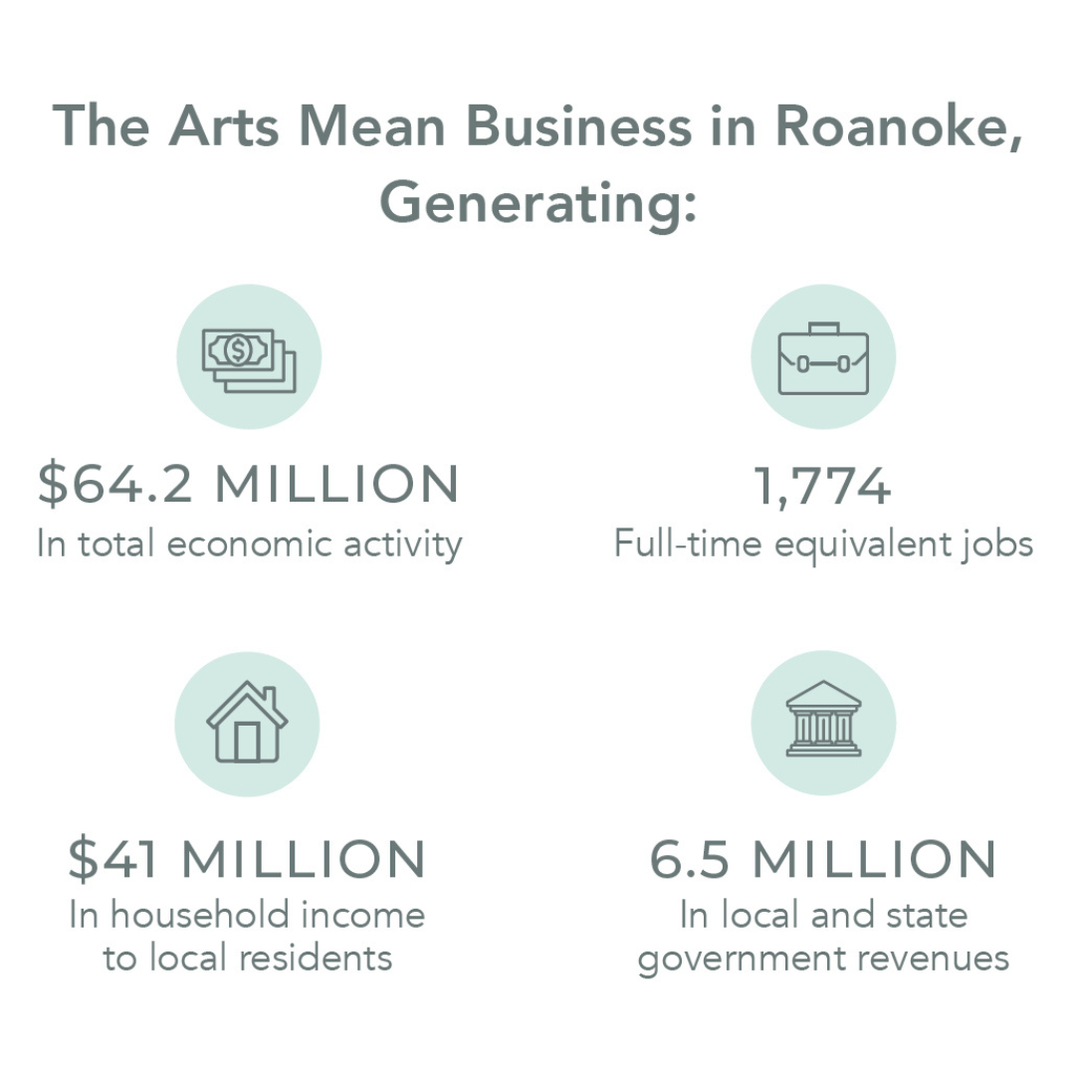

Slide 8
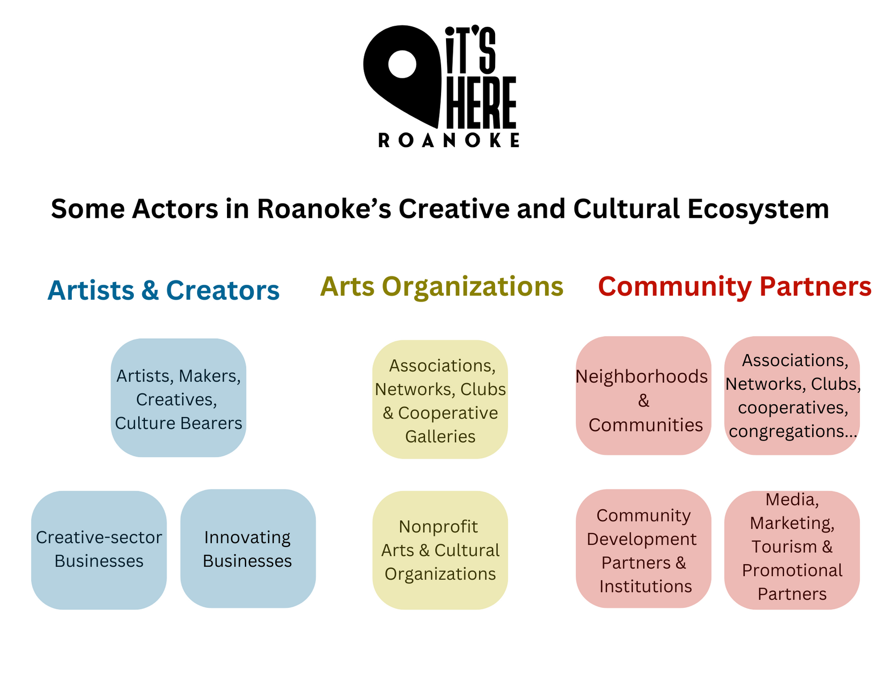

Slide 10
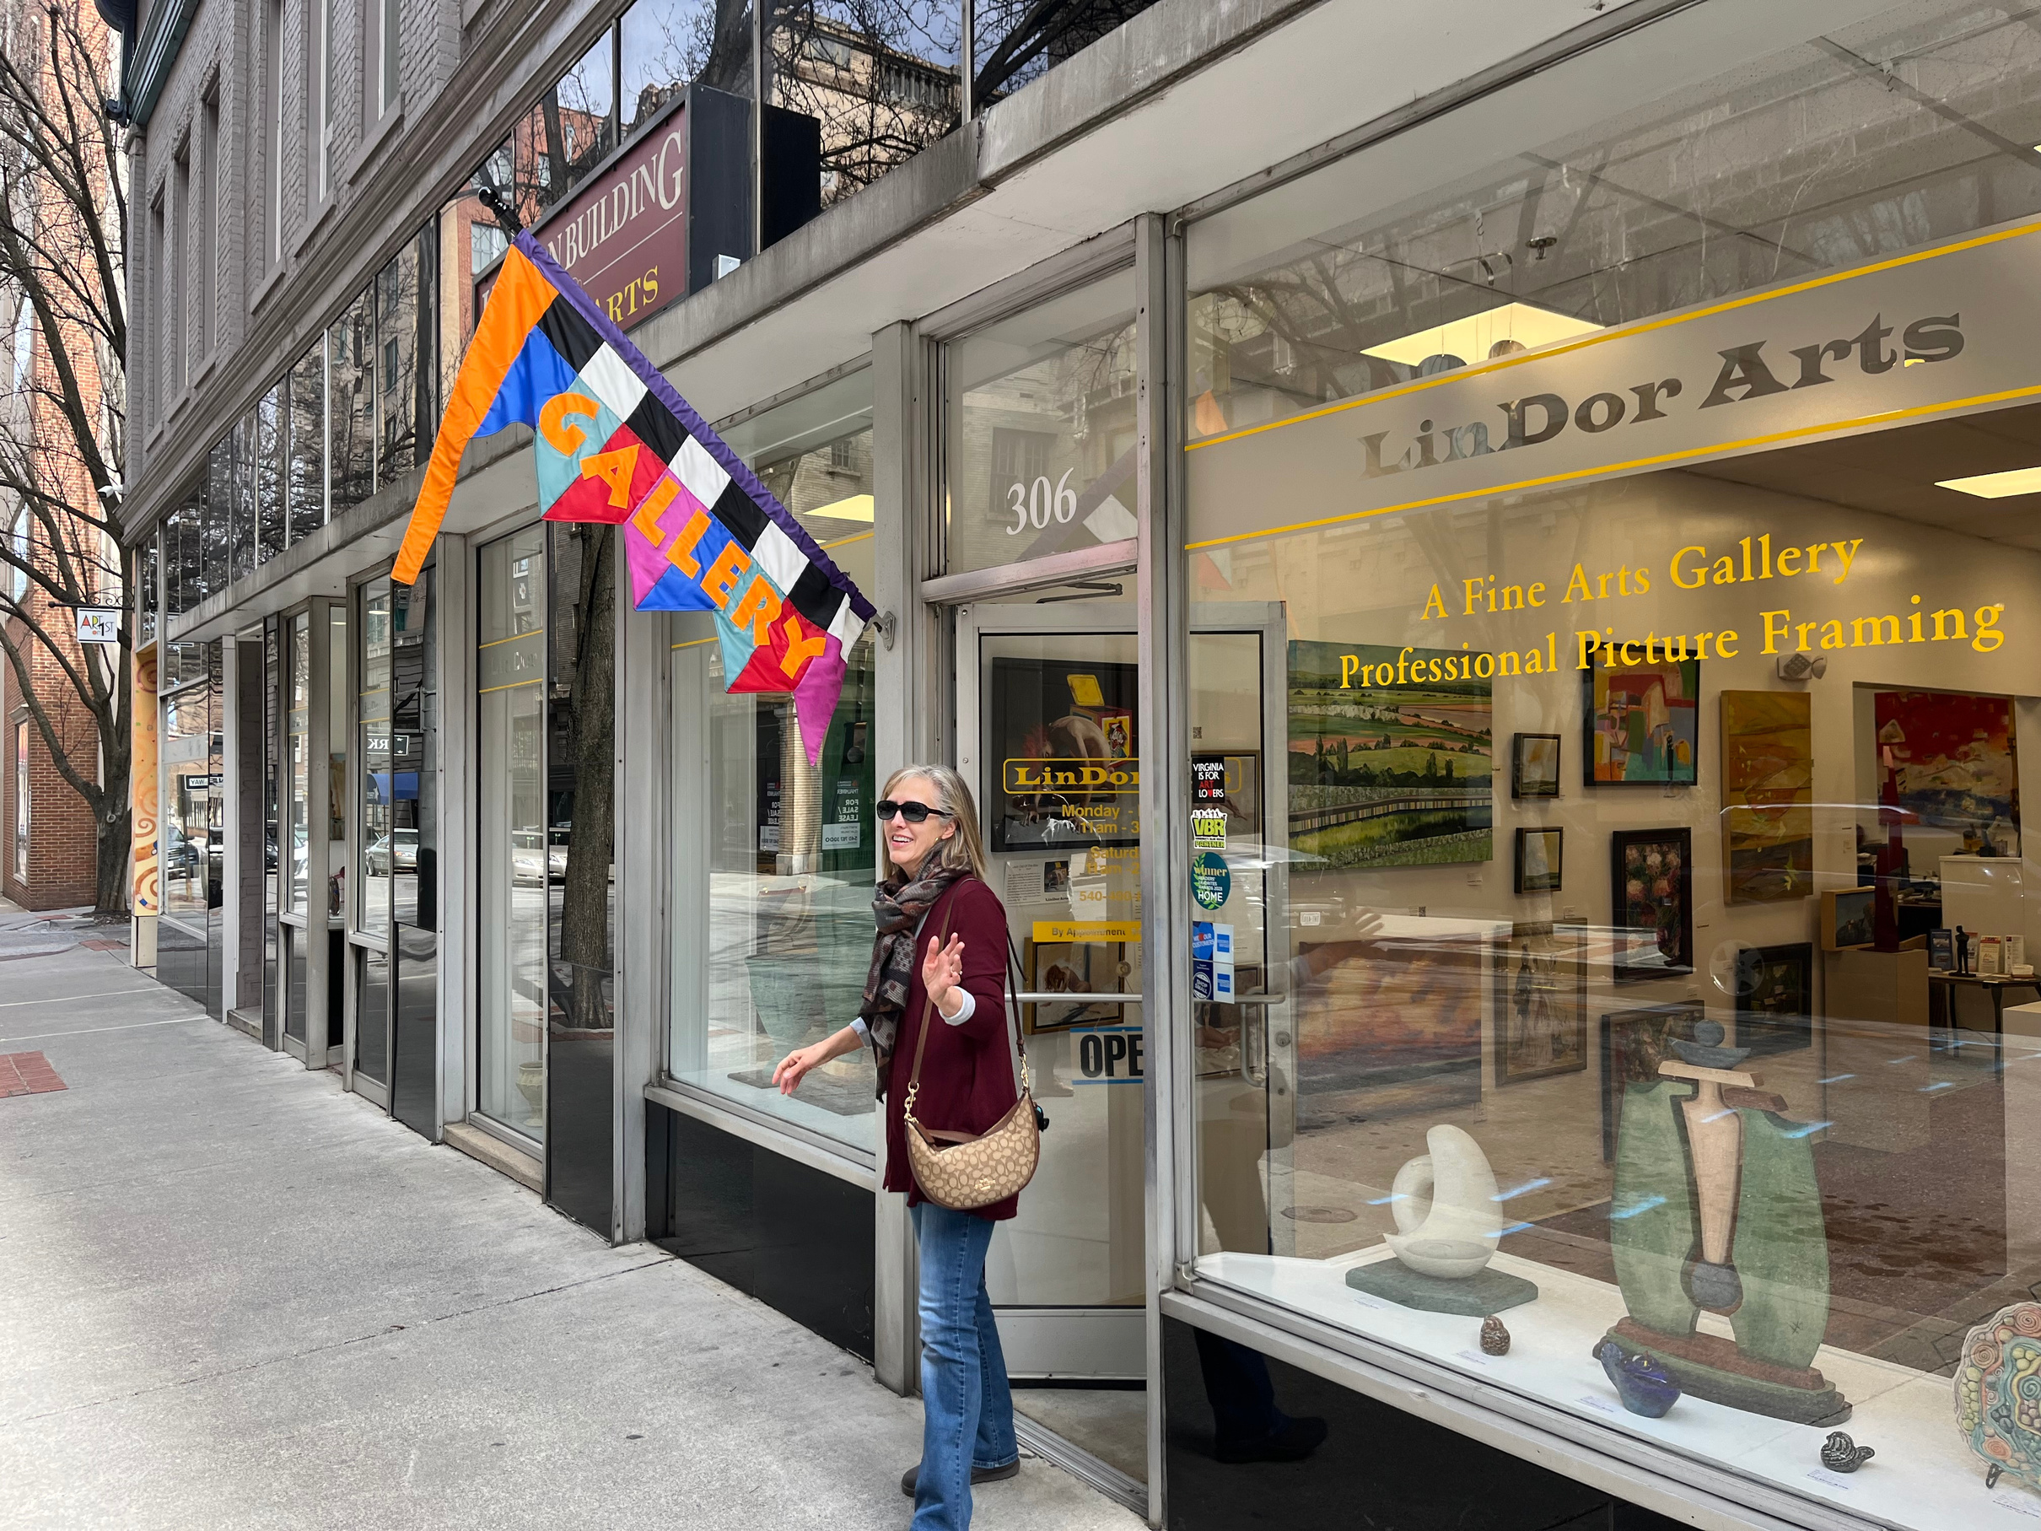

Slide 11


Slide 12
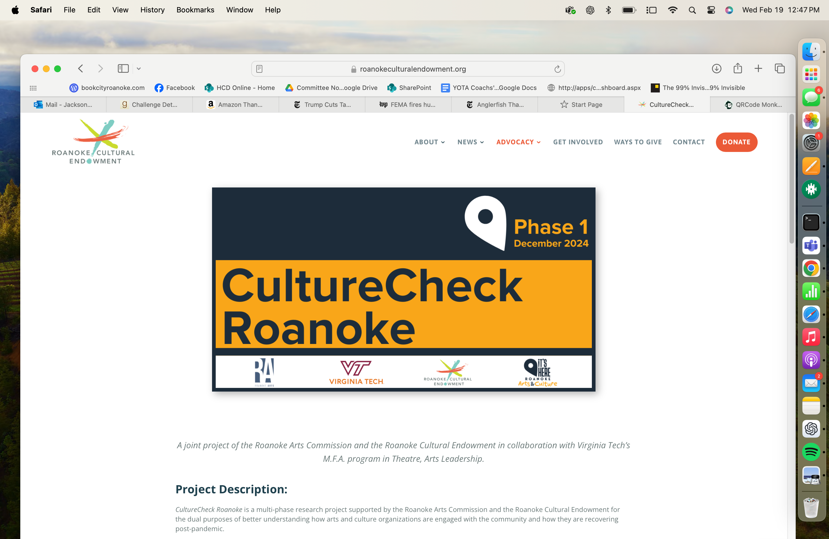
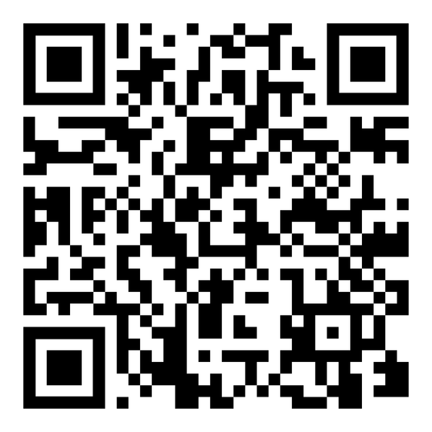
roanokeculturalendowment.org/culturecheck

Slide 13
Roanoke’s arts and culture organizations have been resilient post-pandemic and have resourcefully sought to adapt their engagement methods to maintain audiences and donors.
However, this research suggests that Roanoke's arts and culture organizations face significant funding challenges, including heavy reliance on grants, rising operational costs, and economic uncertainties.

Slide 15
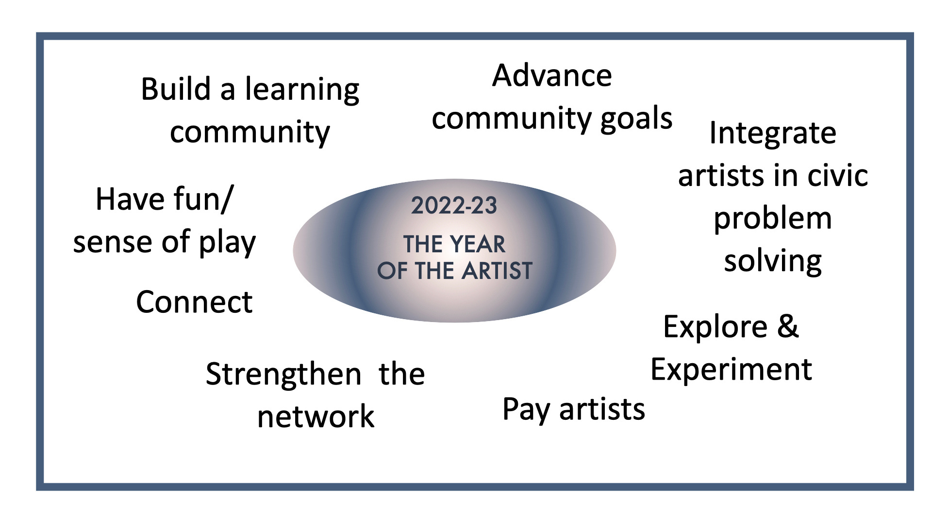

Slide 16
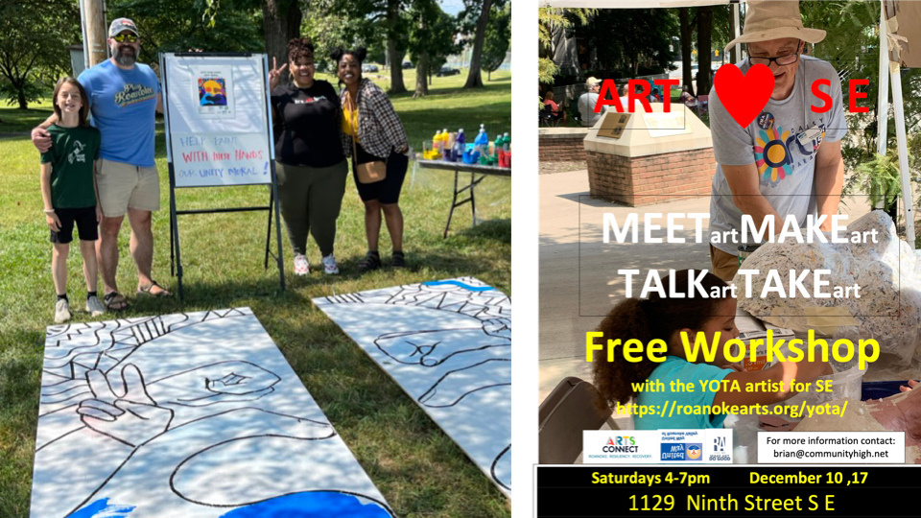
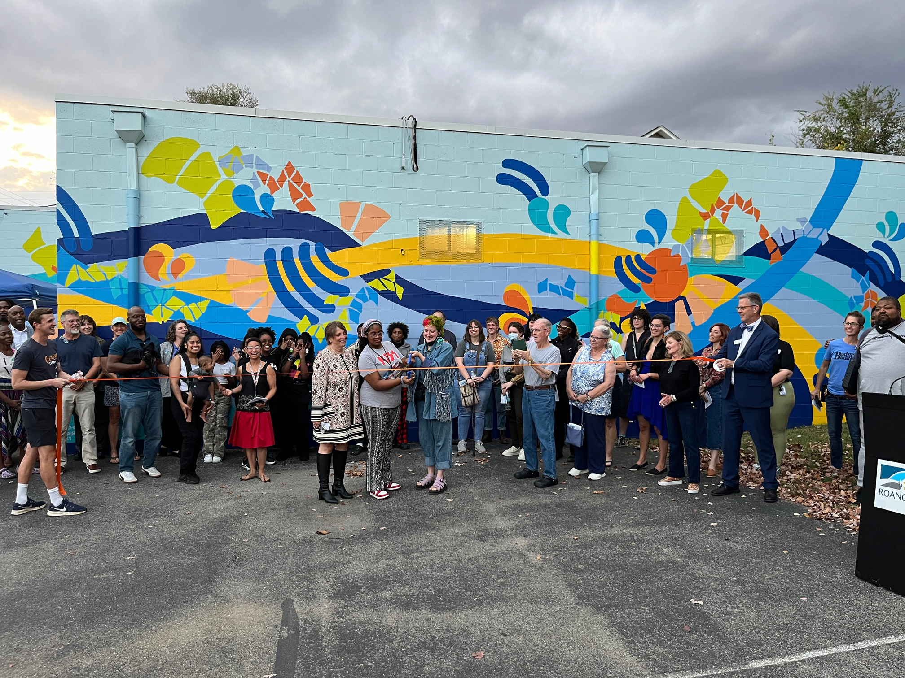
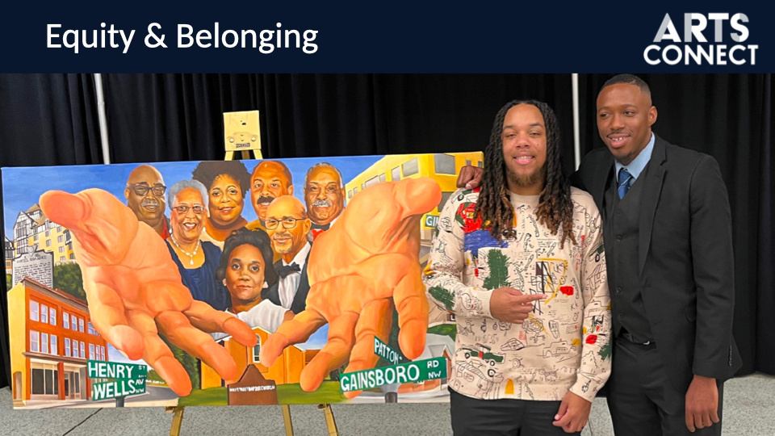
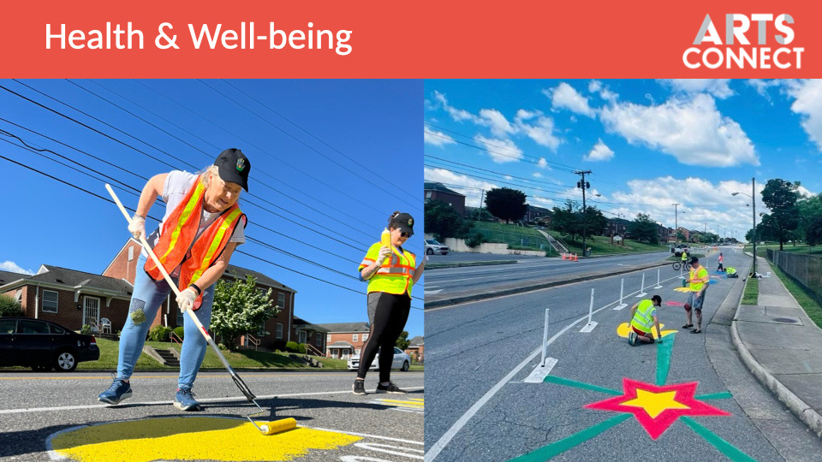

Slide 17
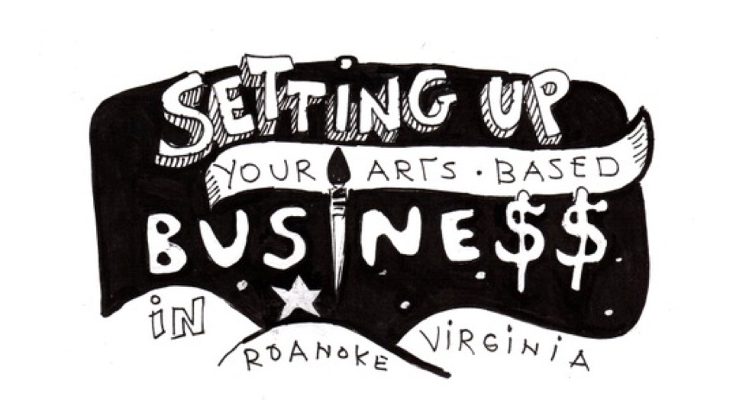

Slide 19
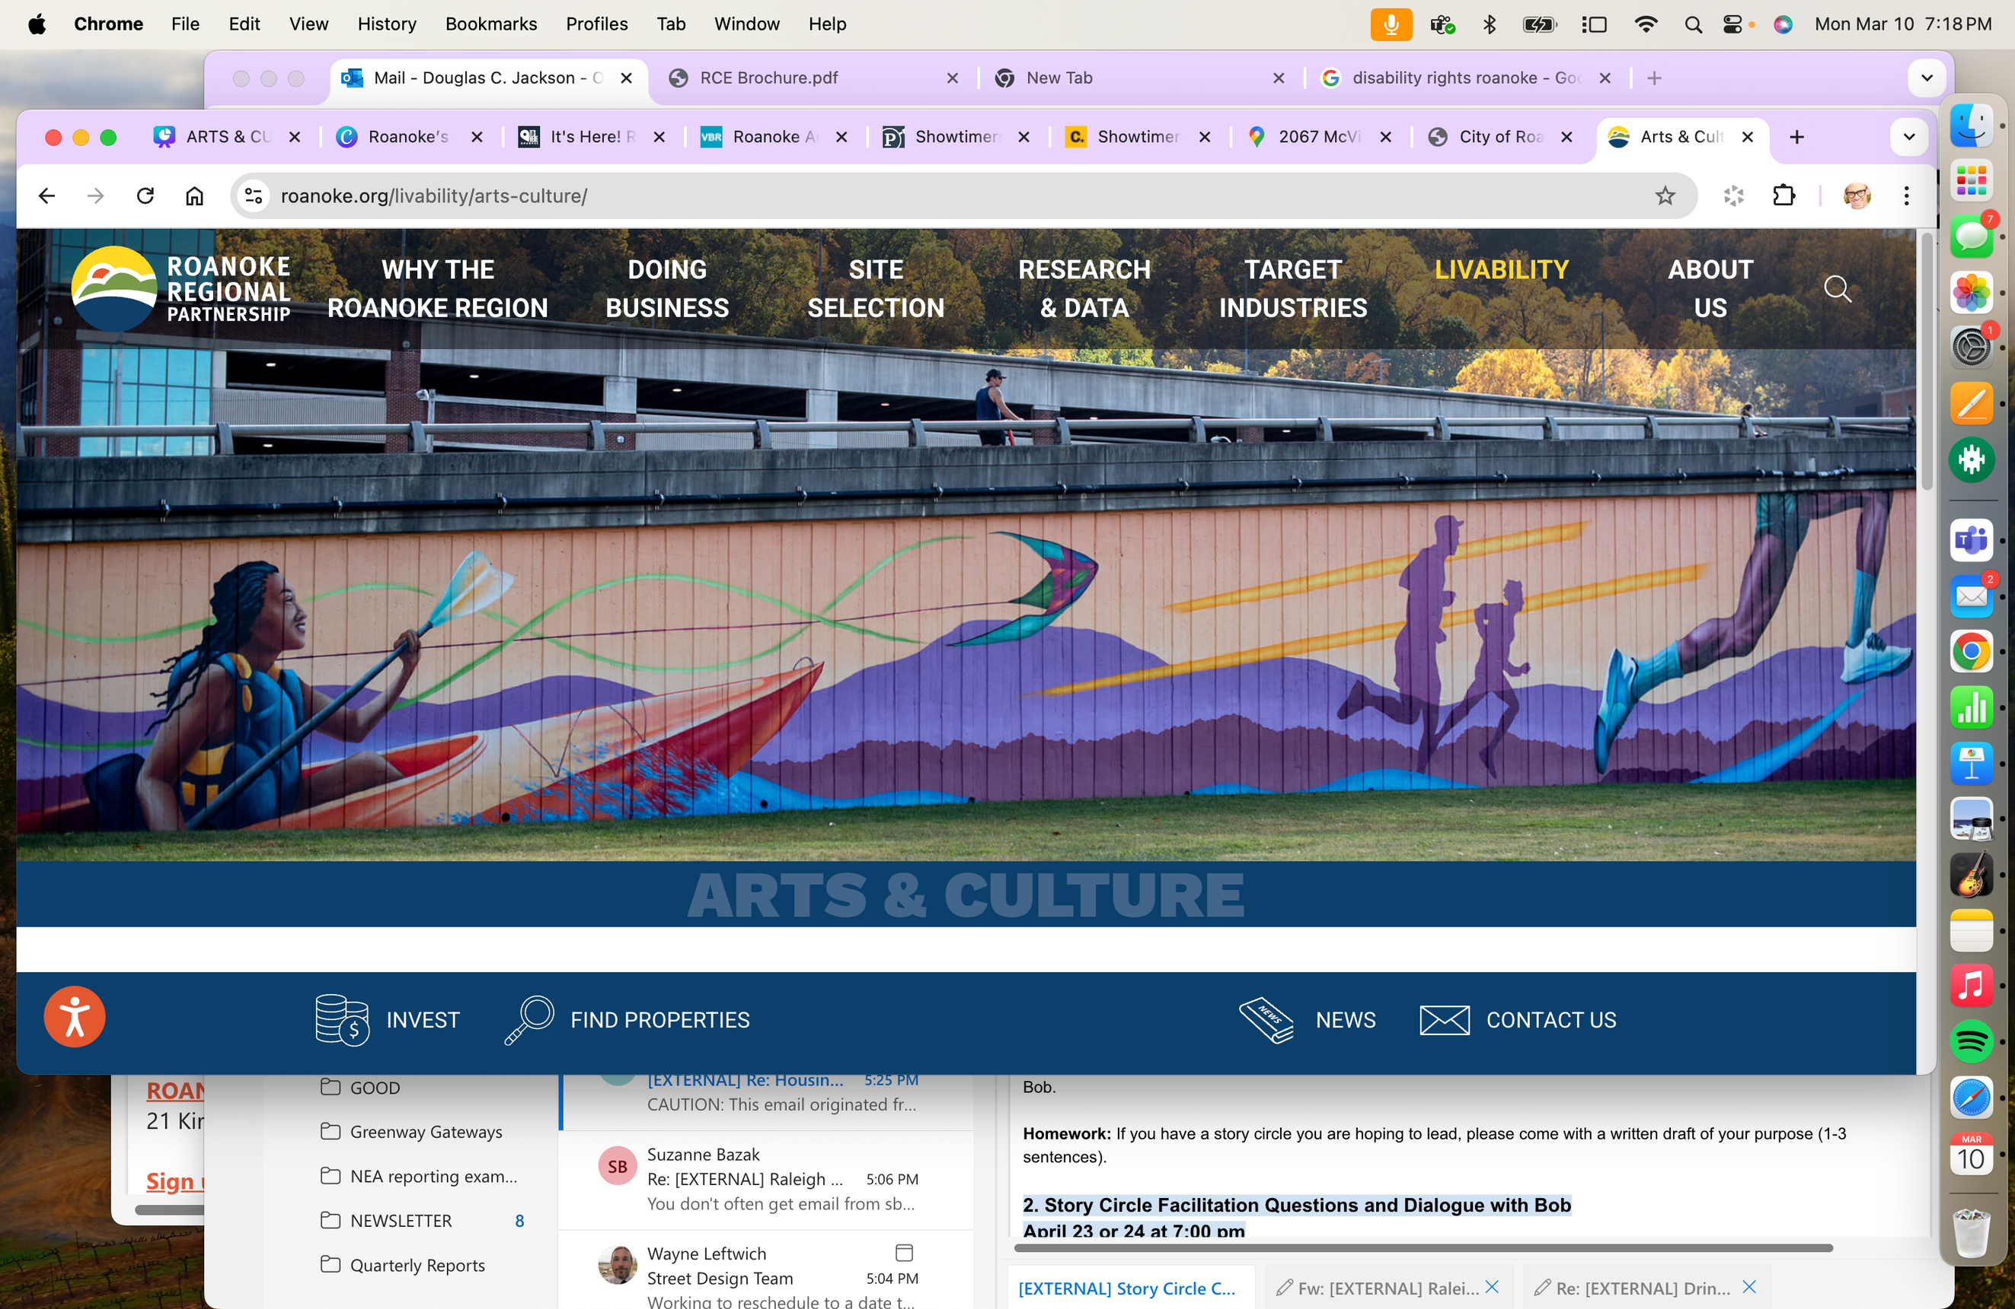

Slide 20
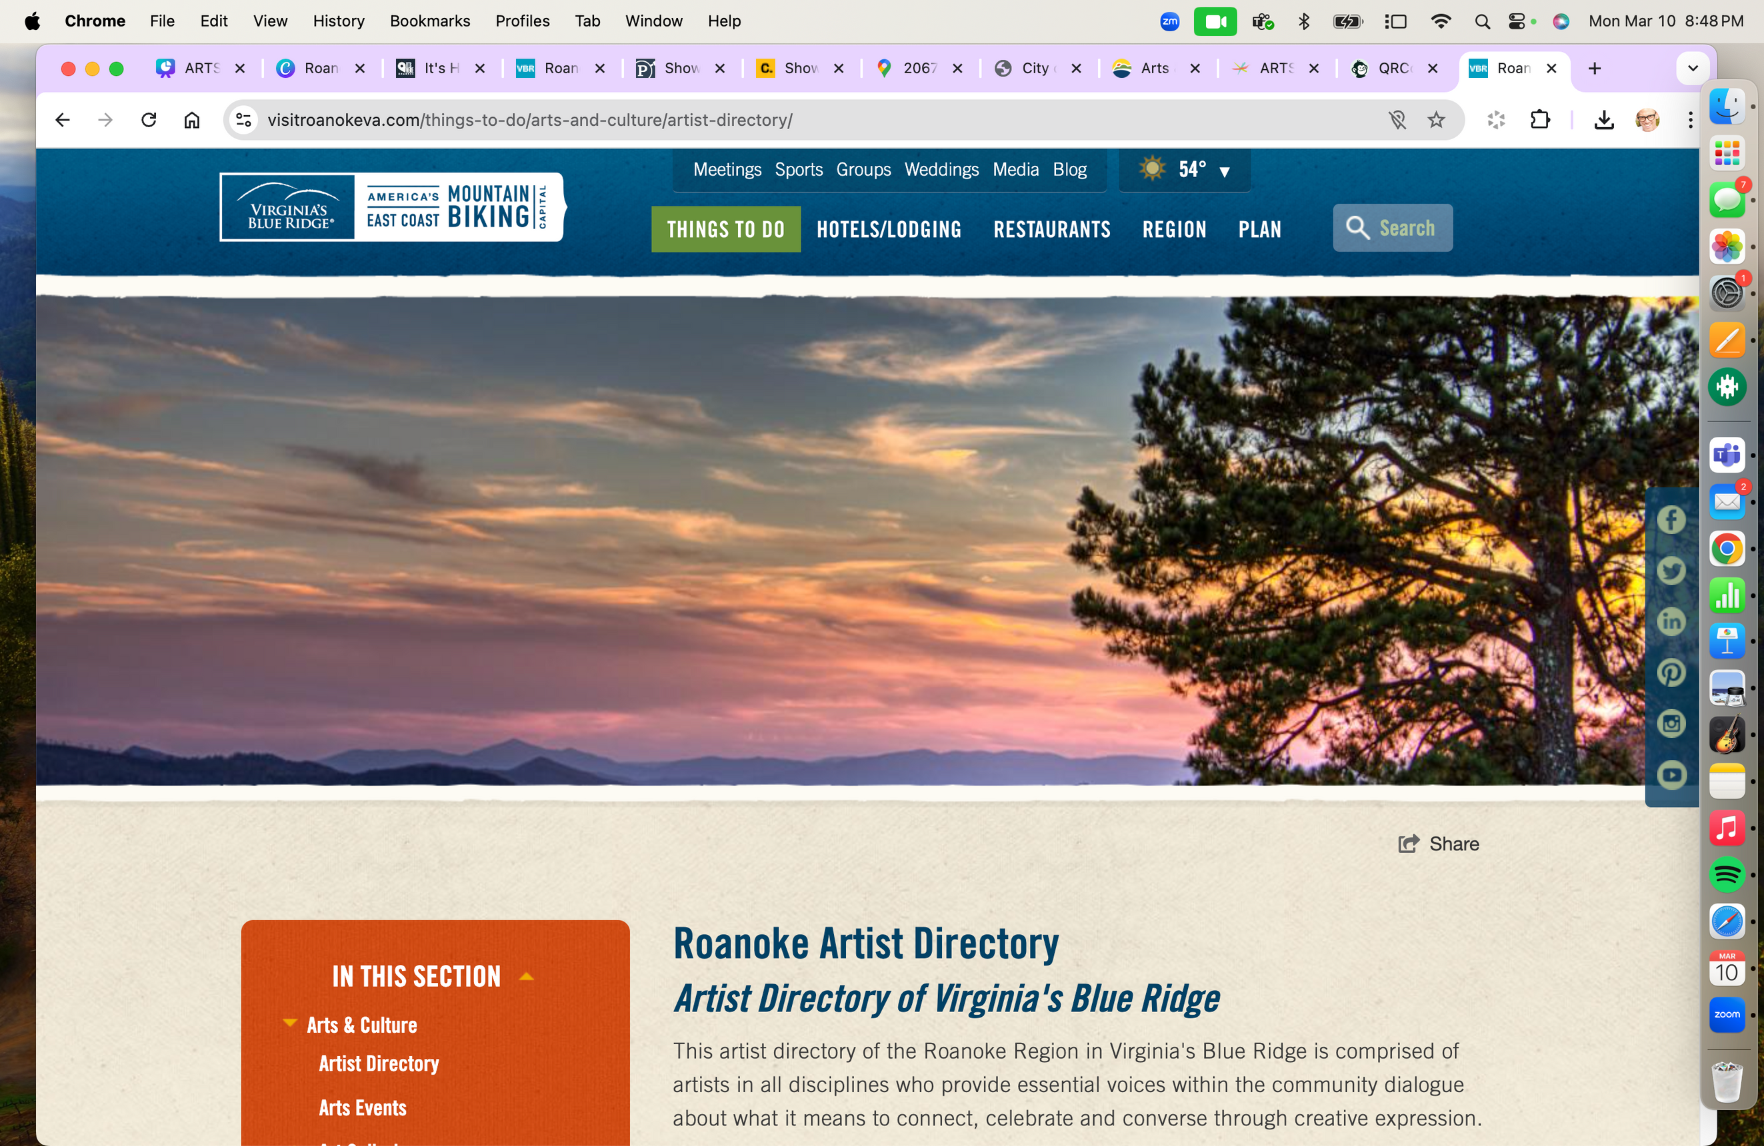
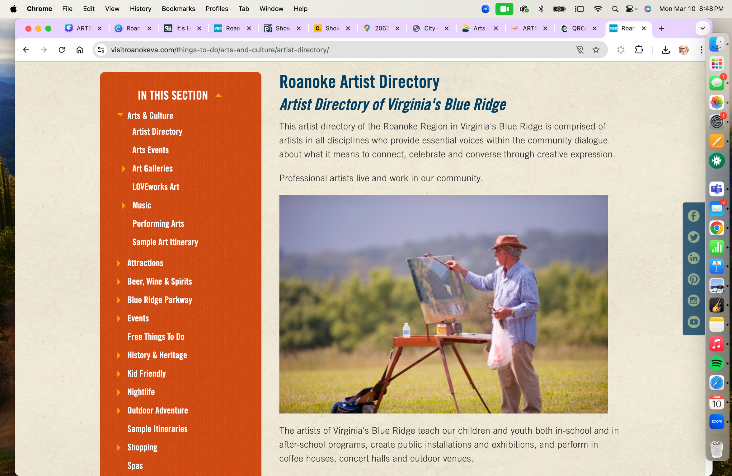

Slide 21
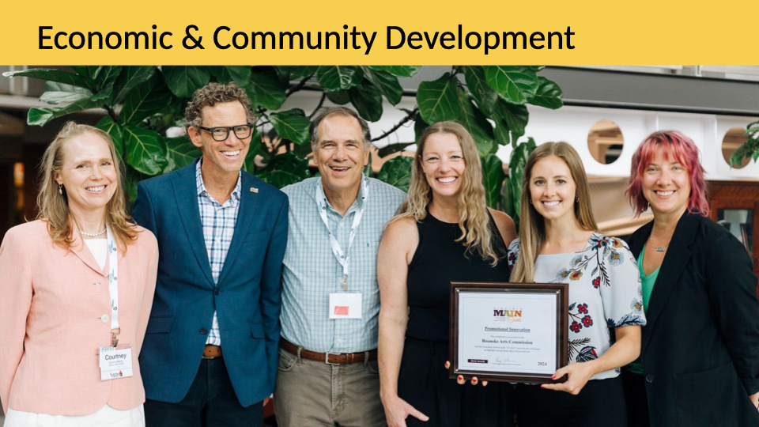

Slide 22
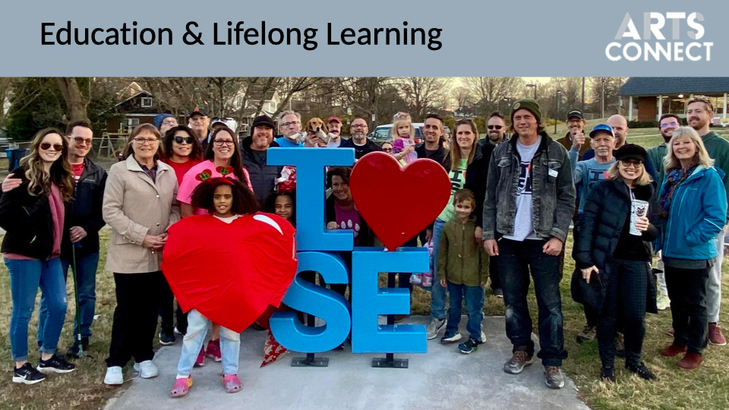

Slide 23


Slide 24
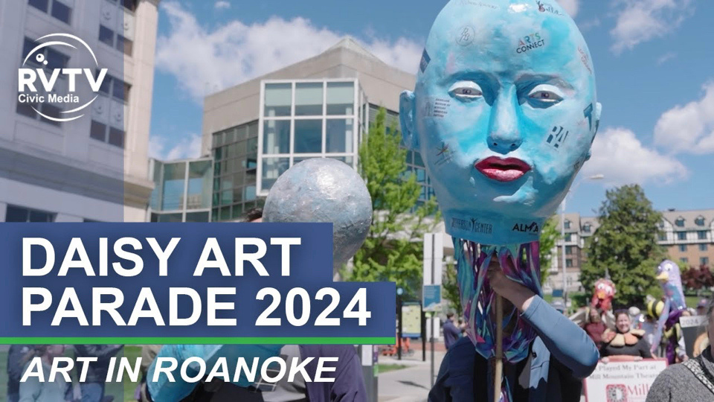

Slide 25

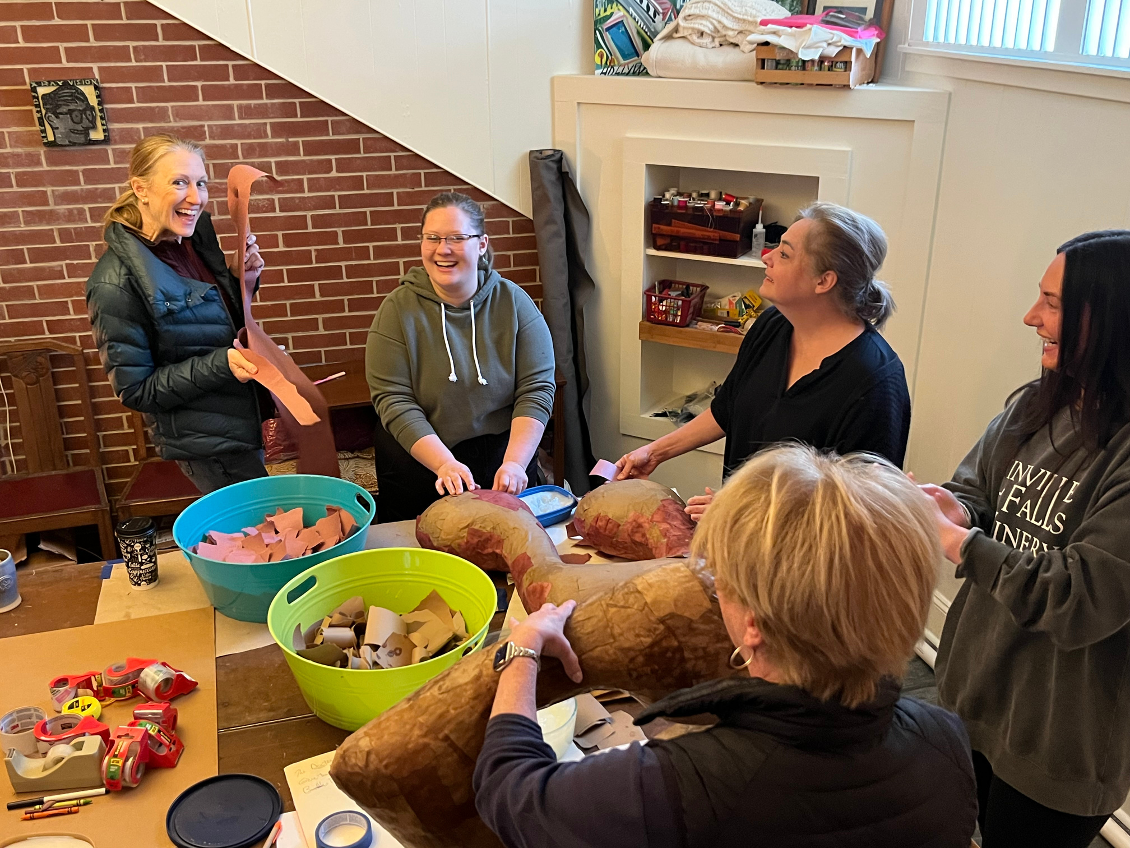

Slide 26
RESOURCES
Program Grants - RAC
Collective Operating Endowment - RCE
Convening - Both
Some Collective Training - Both
Advocacy & Planning Support - Both

Slide 27
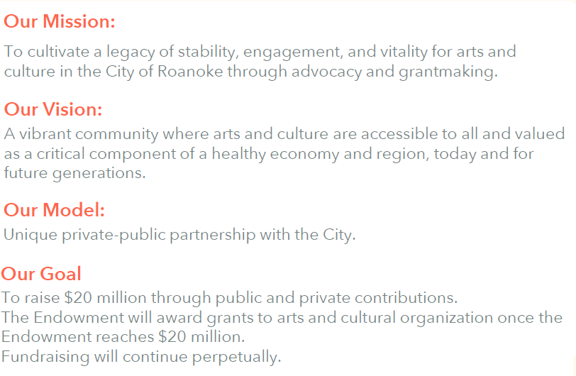
Roanoke Cultural Endowment

Slide 28
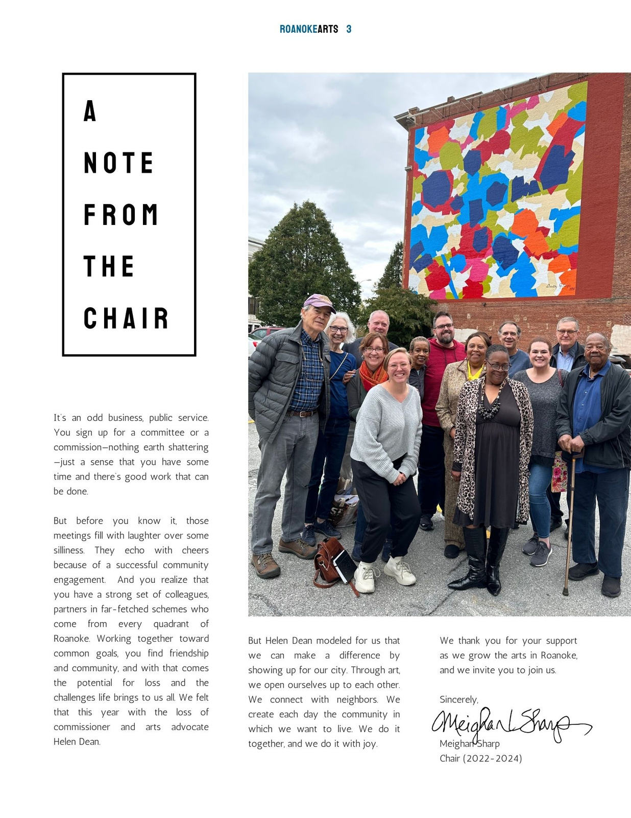
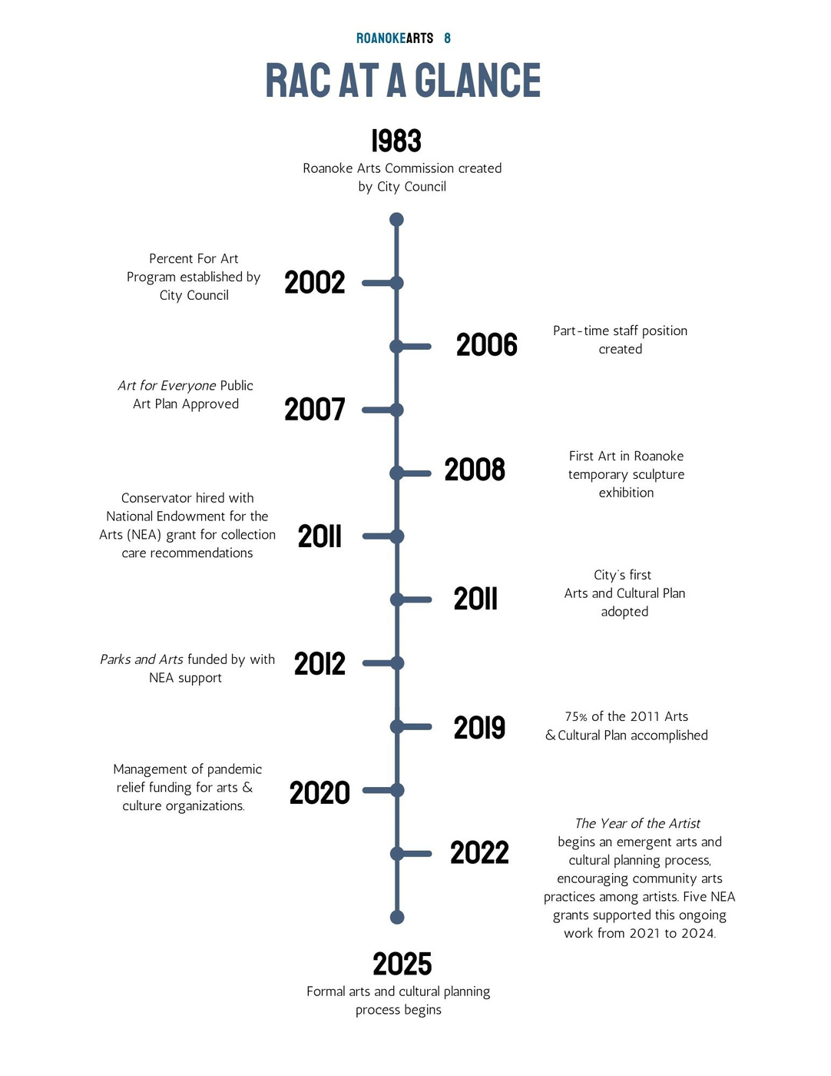


Slide 29
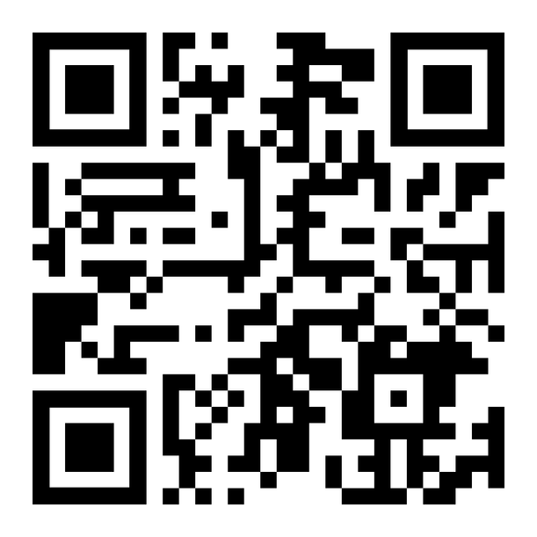
ROANOKE ARTS & CULTURAL PLAN
www.roanokearts.org/plan

Slide 30
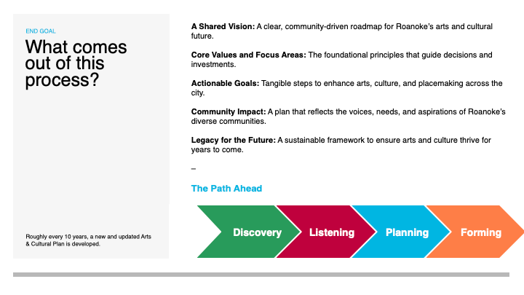

Slide 31
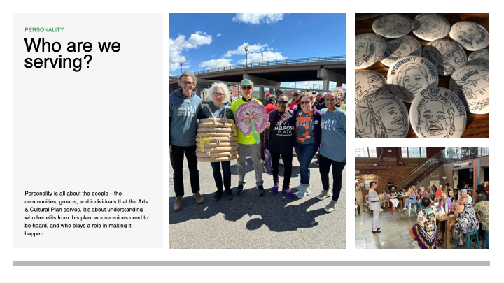

Slide 32
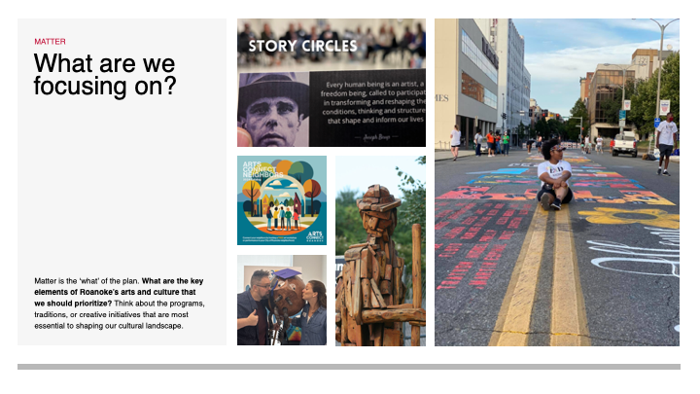

Slide 33
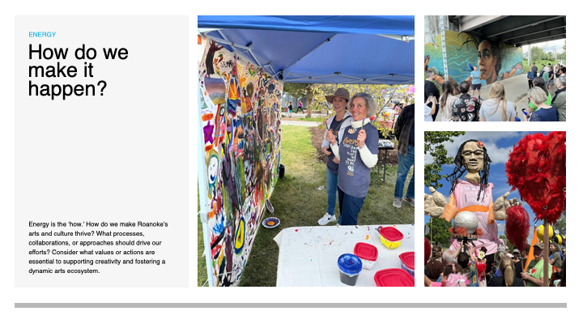

Slide 34
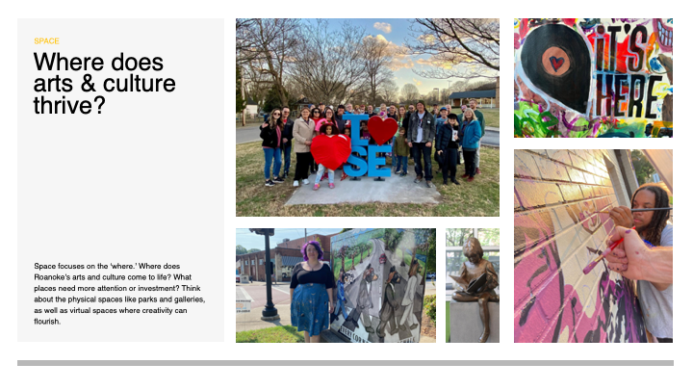

Slide 35
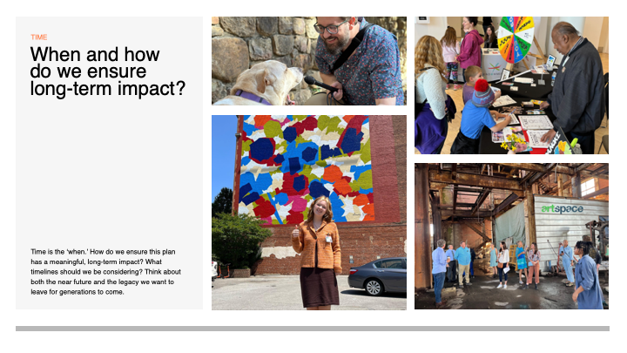

Slide 36



Slide 37
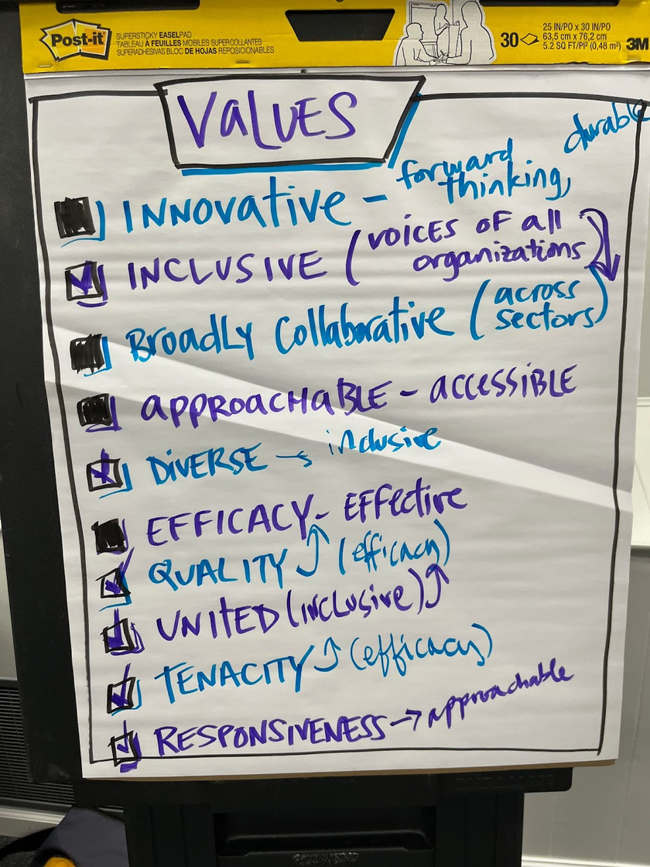
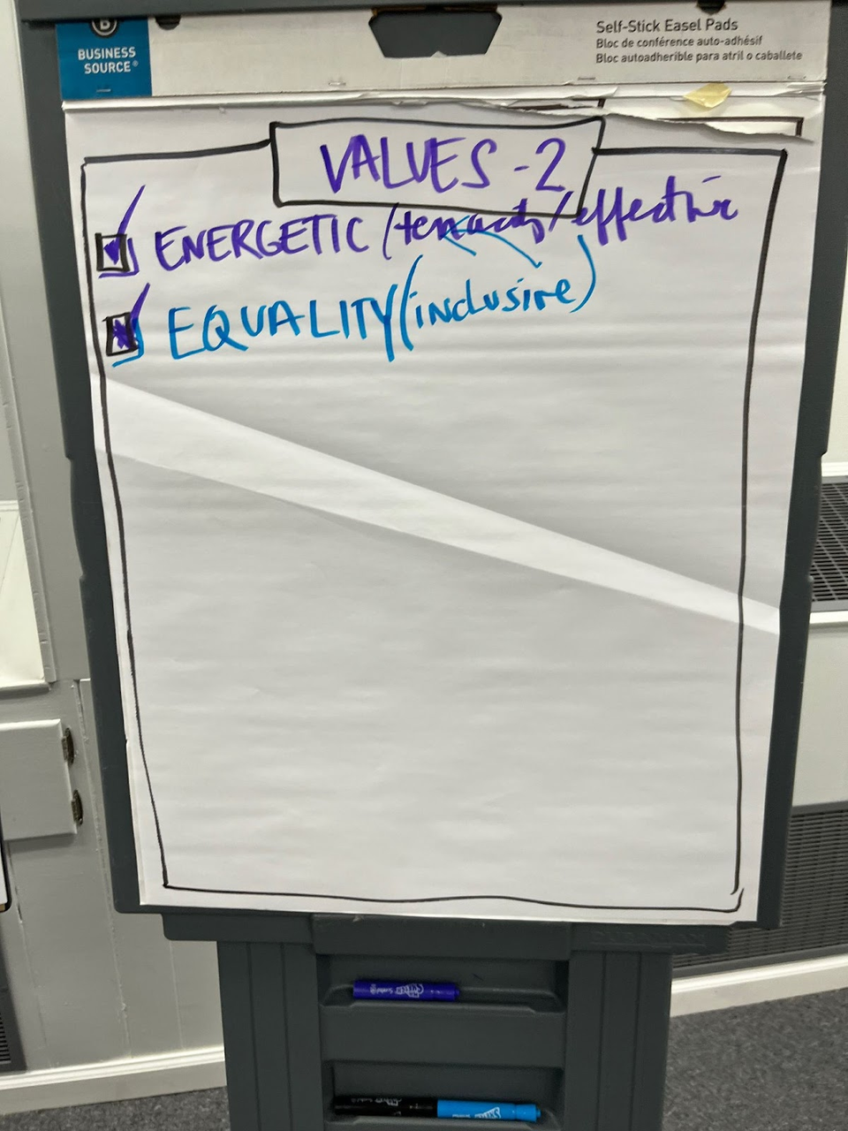
  Innovative
  Broadly collaborative
  Accessible
  High-Impact

Slide 38
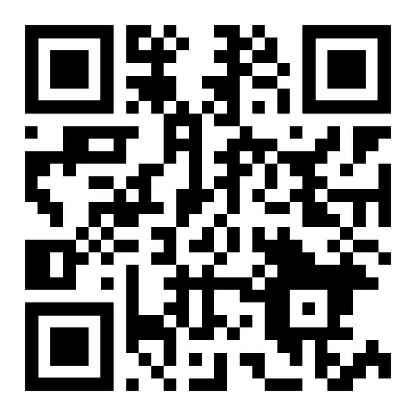
COLLECTIVE
ARTS & CULTURE
BRANDING
www.itshereroanoke.org

Slide 39


Slide 40
OPPORTUNITIES
"It's Here" Community Awareness Opportunities
        Roanoke Arts Pop, March 7-8
        Daisy Art Parade, May 10
        Local Colors Festival, May 17
        VTCSOM XPO, Aug.
        RCPS New Educators Orientation, Aug.
        RSO Symphony Under the Stars, Sept.
UPCOMING

Slide 41
THANKS!

